Slide 1
Hackathon 2
Job Requirements
For Data Analyst Positions
Group 15

Slide 2



Topic Modeling
Preparation
Lemmatisation
Formed trigrams and bigrams
Put each document in Corpus
Topic Modelling
Latent Dirichlet Allocation (LDA) using 20 Components
Found Top 10 Words for each of the Topics
Found N_topics according to which gave the highest coherence scores and best insight
Data Cleaning
- Removed Emails, Line Characters, and Quotations
- Used stopwords to avoid terms unrelated to the Job Requirements

Slide 3
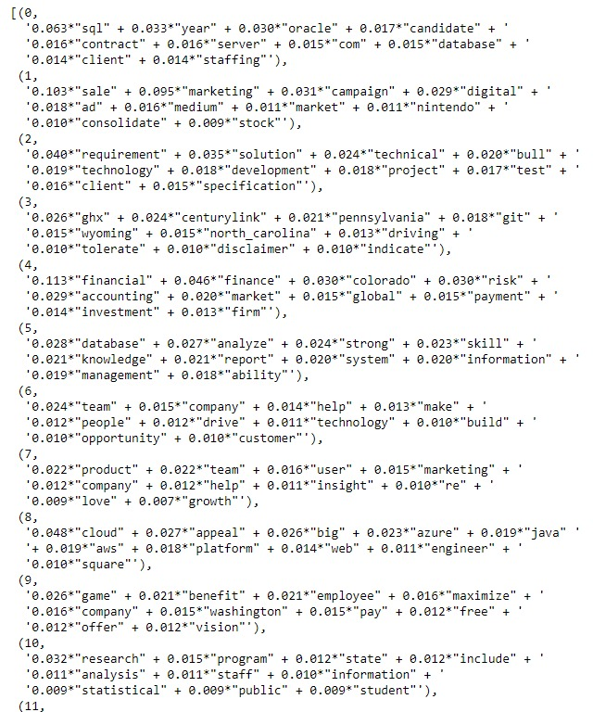

Topics Found
Sample of Topics
Topic Number and Name
T0: Database/Data-Management software experience | T1: Digital marketing/sales experience
T2: Technical/Technology solutions experience | T3: Sales
T4: Financial/Accounting/Investment/Risk analysis experience | T5: Strong analysis skills and knowledge
T6: Team work and managing people skills | T7: Product marketing and growth insights
T8: Big data and cloud services | T9: Salary/benefits pay scheme
T10: Statistical research experience | T11: Anti-discrimination company
T12: Dashboard and visualisation tools | T13: Project system requirements
T14: Government/Defence/Anti-criminal roles | T15: Insurance experience
T16: Recruiting | T17: High standards and quality of work
T18: Communication skills with team, customers | T19: Experience in healthcare/medical roles

Slide 4
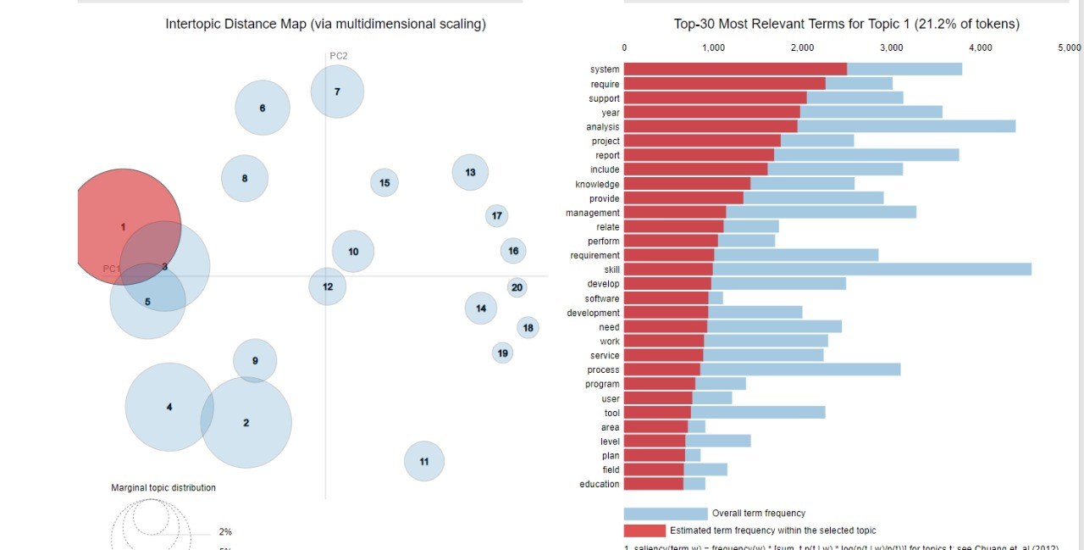
Multidimensional Scaling
Word Analysis for each topic
Key words related to different job requirements are clustered together
For example in the top left jobs requiring technical skills are clustered together
In the Bottom left are graduate positions which are client facing
Top right you can see job requirements related to a startup where collaboration, growth and passion are key

Slide 5

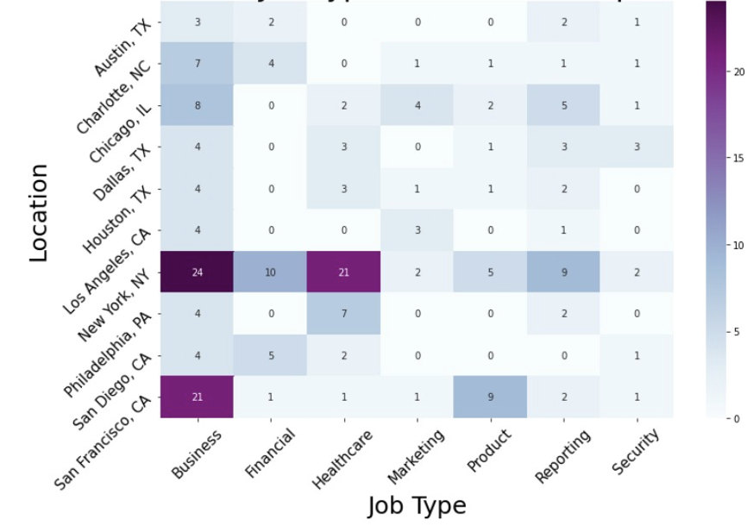
Location vs Job Type with Dominant Topic Count!!!
Business and Healthcare sectors have the most topic occurrences in New York and SanFran
Hence performed topic modelling on healthcare and Business/IT sector

Slide 6

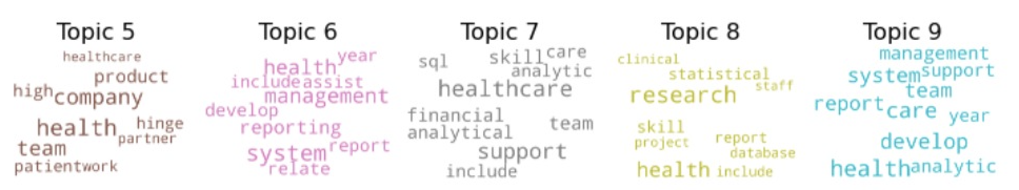

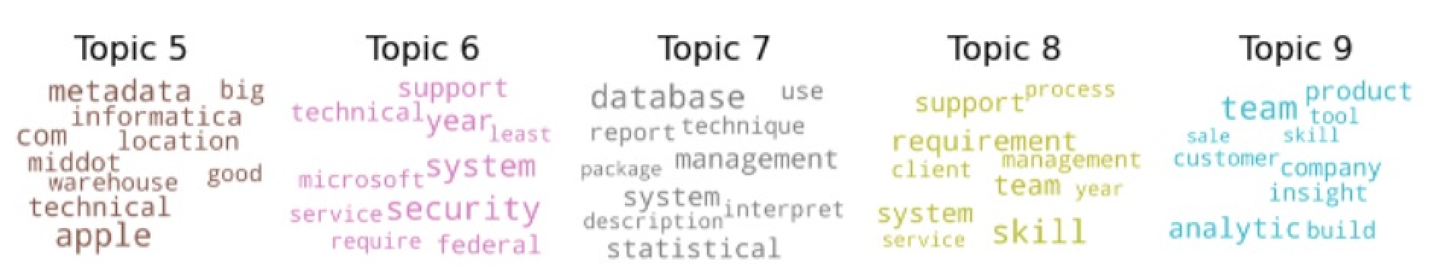
Comparing requirements Sector Wise (Dominant Topics)
Health
Requires skills related to research, supporting and assisting
Requires more soft skills
Coherence Score = .34
IT
Job Requirements are based in technical capabilities with words such as technical, security, and systems
Requires more hard skills
Coherence Score = .39

Slide 7
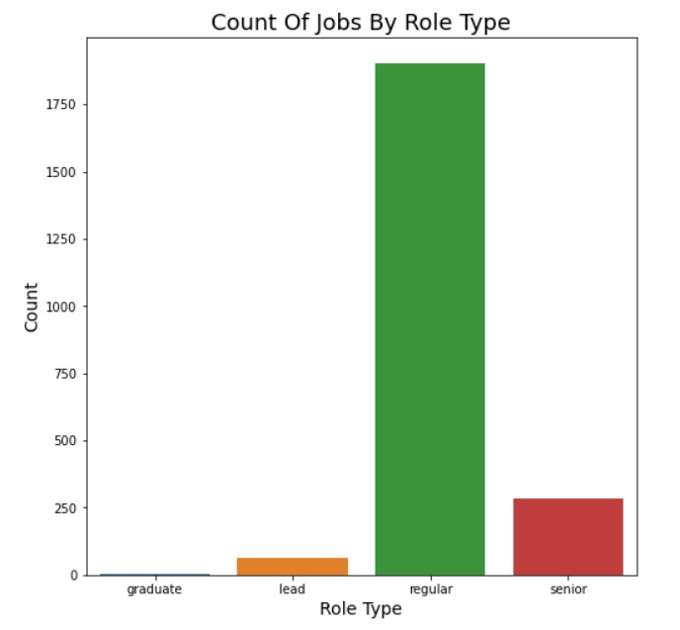
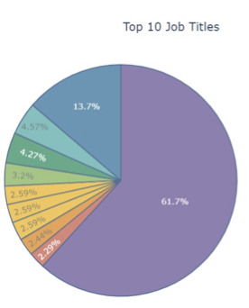
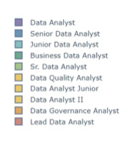
Role Exploration

Slide 8
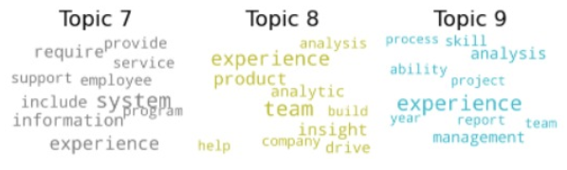
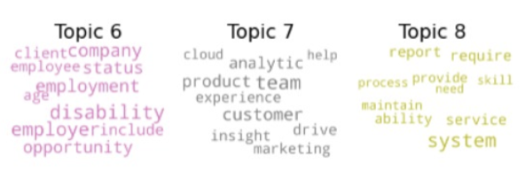
Comparing requirements Role Wise (Dominant Topics)
Senior
Requires skills related to experience, knowledge, and drive
Requires more leadership capabilities
Coherence Score = .38
Regular
Requires skills related to age, employment, and report
Requires specific skills in SQL and database
Coherence Score = .45

Slide 9

Thank you!

